Slide 1


Machine Learning in the King County Real Estate Market
A presentation by
Deep
Divers

Slide 2
Outline
The Task
Preparing the data
ML Model Results and Lessons
Business Insights
Conclusion
Notes:
Slide 1: Explain story/problem set and briefly go over approach to achieve outcomes
Business angle:
high accuracy prediction allows company to make a quick initial estimate whether properties are undervalued / overvalued → can be used (for instance) to provide sellors with better guidance concerning pricing

Slide 3
The Task
Starting point:
Working for a real estate company, we have a dataset with over 20,000 properties in King County (Seattle, WA)
Objectives:
Our aim is to create value for our company and customers via:
property price prediction model on basis of dataset
determination of factors which affect pricing in the price segment >$650,000
Notes:
Slide 1: Explain story/problem set and briefly go over approach to achieve outcomes
Business angle:
high accuracy prediction allows company to make a quick initial estimate whether properties are undervalued / overvalued → can be used (for instance) to provide sellors with better guidance concerning pricing

Slide 4
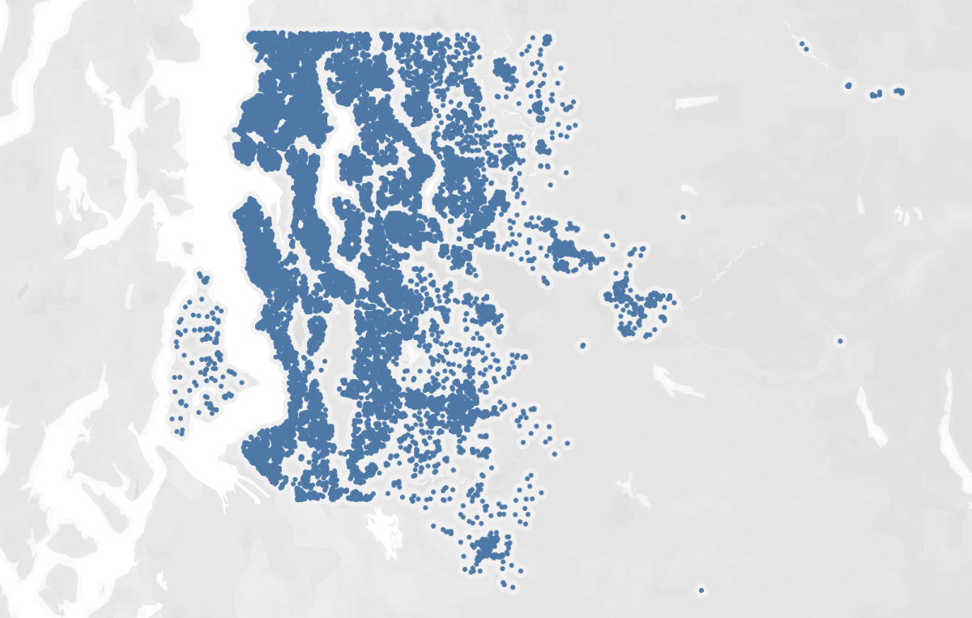
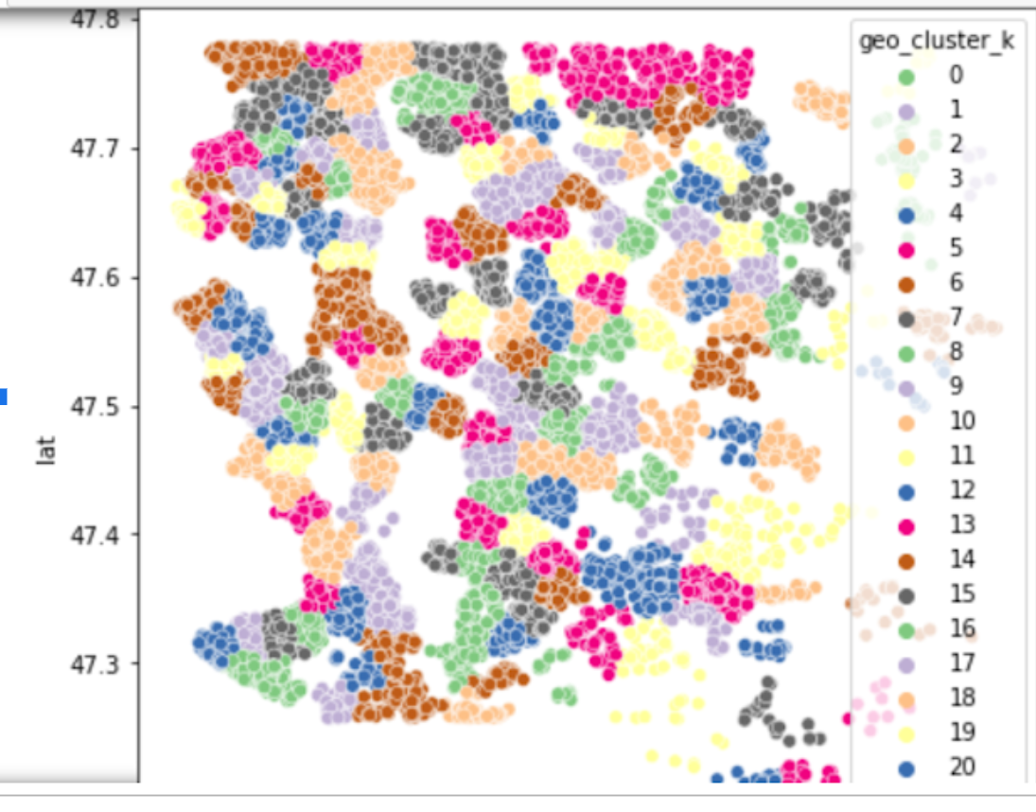

Preparing the data
Cleaning and trimming:
Trimmed geographic outliers (ex: island properties) and reduced dataset to include only properties with a lot size <250,000 sq. ft.
Dropped highly correlated columns
Feature Engineering:
Bins for yr-built, yr-renovated, basement
Organized data into 500 geographic clusters using Lat /Long and Kmeans algorithm
Converted Lat/Long into street addresses using Geopy
Notes:
Slide 2: Methods and thought processes in problem solving

Slide 5
ML Model Results
Scaling:
Robust scaler provided slightly better results than Normalizer (approx. 2 percentage points)
Method:
Linear regression provided significantly better results than K Nearest Neighbour
Best results:
R2 = 0. 853...
MAE = 84357
Lessons:
Binning and clustering properties geographically with Kmeans improved results
Trying to train model with street addresses (street names, towns) was extremely slow and did not work
Notes:
Slide 2: Methods and thought processes in problem solving

Slide 6

Insights concerning High Value Properties
Factors Influencing High Value Properties:
King County grade score
The property’s views
Access to a waterfront
Number of bathrooms
Sq. Ft. Above and Sq. Ft. Living

Slide 7
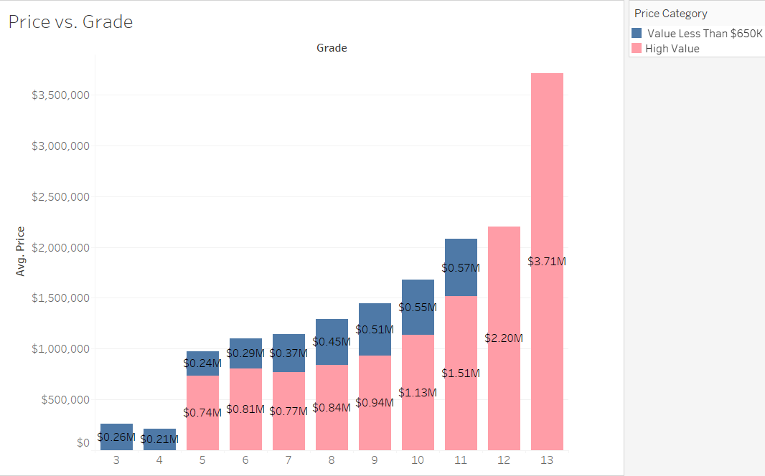
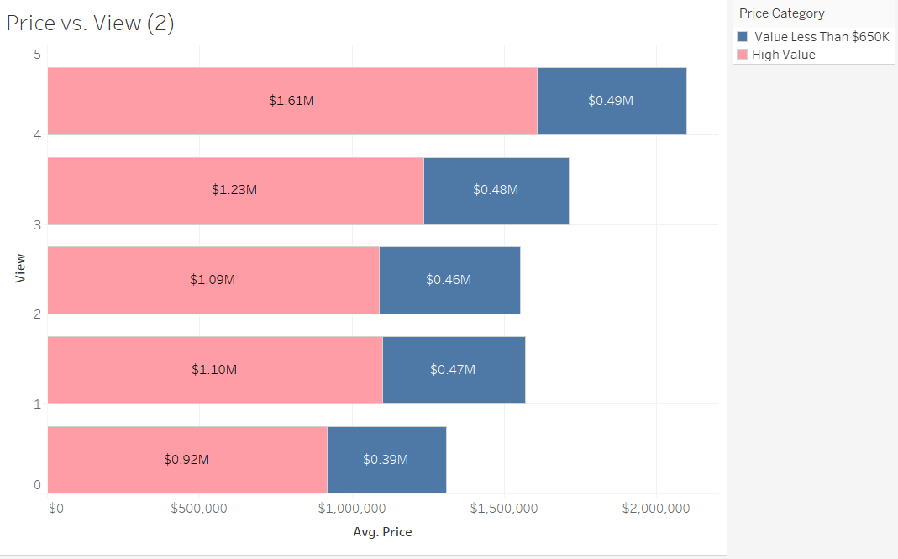
Grade & View vs. Avg Price Comparison

Slide 8
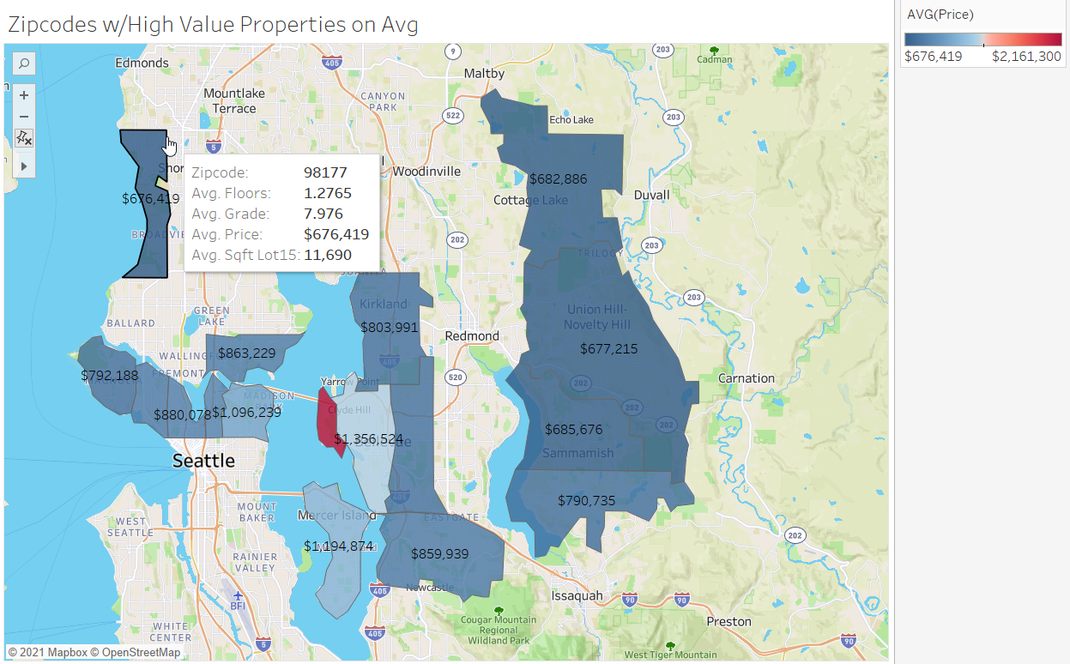

Slide 9




Conclusion
Additional hyperlocal data points to be able to better identify trends and improve prediction accuracy
Potential Business Impact:
Optimize pricing for under- or overvalued properties
Give customers and colleagues a quick reference tool
Create a tool to estimate a property’s value based on a number of factors

Slide 10
Thank you!
A presentation by
Deep
Divers

